Slide 1

Analysis of Superstore’s Product Profitability and Customer Purchase Prediction

Slide 2
Problem Statement
Business Understanding
Data Understanding
Data Preparation
Modeling
Evaluation
TABLE OF CONTENT

Slide 3

PROBLEM STATEMENT
The Super Store is experiencing a decline in sales and wants to identify the underlying factors and develop strategies to improve sales performance.
The store management seeks to understand the causes of the decline, such as changes in customer preferences, increased competition, ineffective marketing efforts, or operational inefficiencies.
They aim to uncover potential opportunities for growth and develop actionable recommendations to increase sales and enhance overall performance.

Slide 4

BUSINESS UNDERSTANDING
To effectively address the problem statement related to Super Store sales, it is crucial to gain an understanding of the business.
Target Market Analysis
Competitive Analysis
Operational Efficiency

Slide 5

DATA UNDERSTANDING
The data we collect from the data.gov
21 Features
9994 Instances

Slide 6

DATA PREPARATION
Data preparation is a crucial step in the data analysis process that involves transforming and cleaning the raw data to make it suitable for analysis. By preparing the data properly, we can ensure its quality, completeness, and compatibility with the chosen analytical techniques or models.
Data Cleaning: Checking for Missing values such as Null in the dataset.
One Hot Encoder: Data preparation technique, especially when dealing with categorical variables.
Descriptive statistics: It can be utilized during the data preparation phase to gain insights into the data and understand its characteristics.

Slide 7
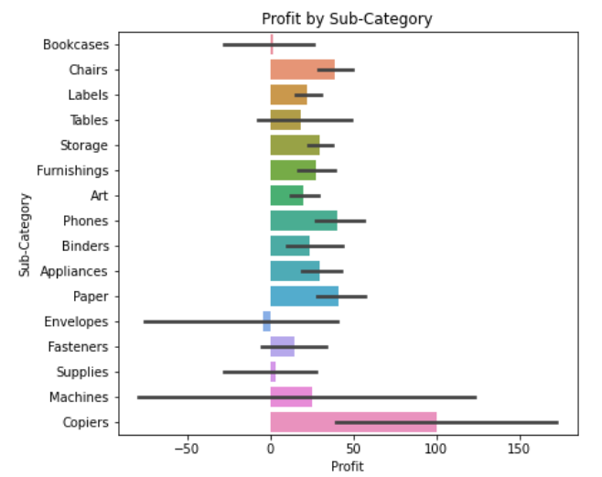
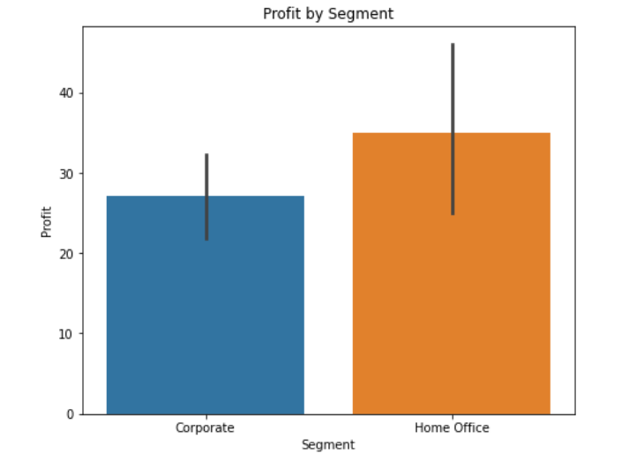
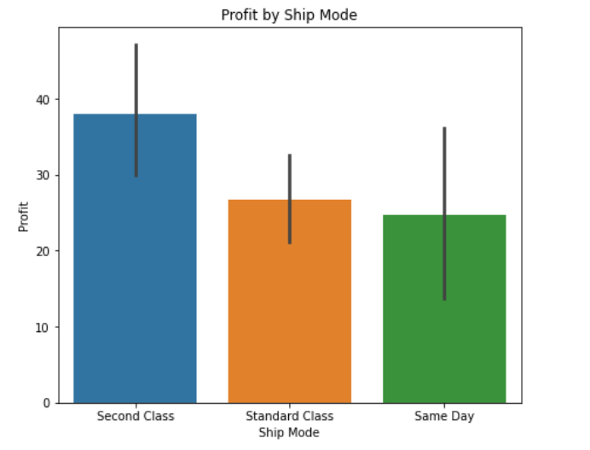
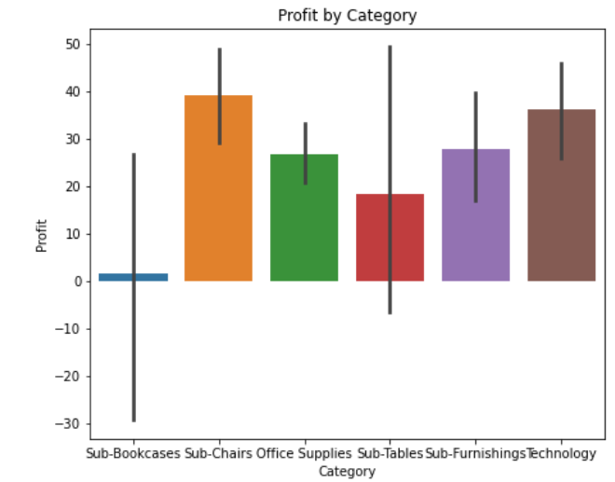
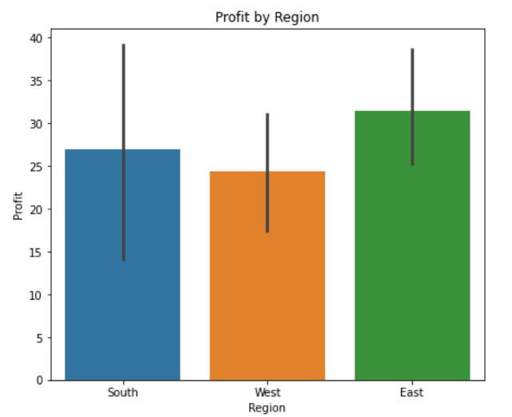
EXPLORATORY DATA ANALYSIS
Copiers have the highest profit for the sub-category.
Chairs have the highest profit for the category.
Home Office has the highest profit for the segments.
Second Class has the highest profit for the Shipping Mode.
East has the highest profit for the Region.

Slide 8

DATA MODELLING
Feature Selection:
Feature selection is a process where we selected the features in the data that contribute most to the prediction variable or output. Having irrelevant features in the data can decrease the accuracy of many models, especially algorithms like linear and logistic regression.
Three benefits of performing feature selection before modelling the data are:
Reduces Overfitting: Less redundant data means less opportunity to make decisions based on noise.
Improves Accuracy: Less misleading data means modeling accuracy improves.
Reduces Training Time: Fewer data means that algorithms train faster. modeling

Slide 9
DATA MODELLING
Model Selection:
Since our project is on regression, we use models like Linear Regression, Random Forest Regressor, Gradient Boosting Regressor, and SVM to select the best fit based on the accuracy and RMSE.
Why do we use RMSE in regression analysis?
RMSE is a useful way to see how well a regression model is able to fit a dataset. The larger the RMSE, the larger the difference between the predicted and observed values, which means the worse a regression model fits the data.

Slide 10

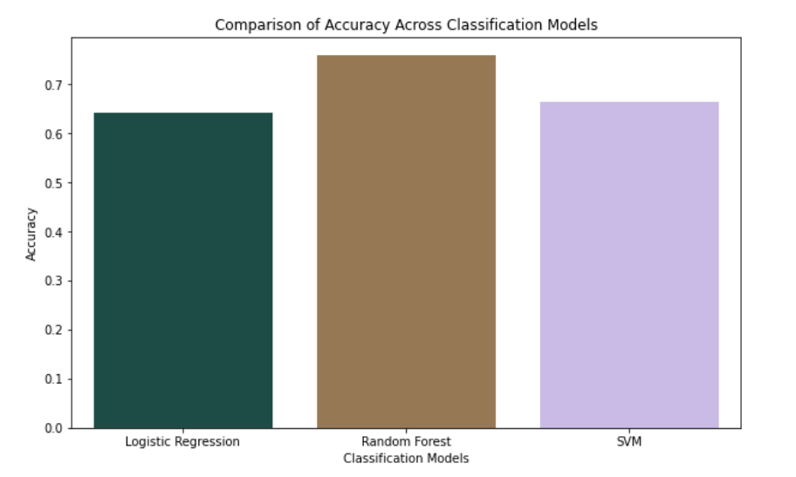
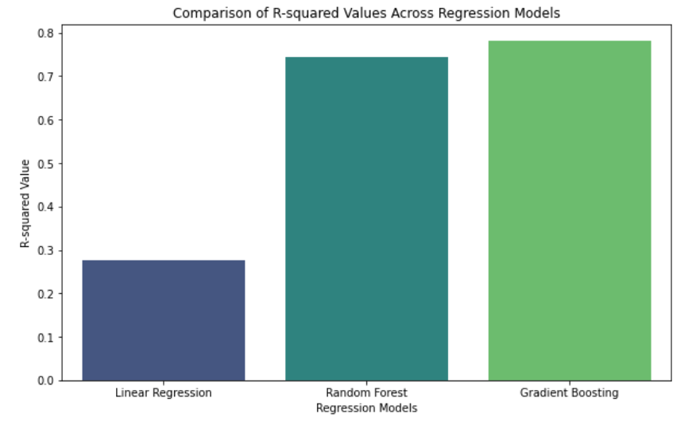
EVALUATION
The bar chart above visually compares the accuracy of the three classification models:
Logistic Regression shows the lowest accuracy, indicating it's less effective for this particular classification task.
Random Forest Classifier stands out with the highest accuracy, suggesting it is the most effective model for predicting product categories based on customer purchase history and demographics.
Support Vector Machines (SVM) displays moderate accuracy, placing it between Logistic Regression and Random Forest.
The bar chart above visually compares the R-squared values of the three regression models. As evident from the chart:
Linear Regression has the lowest R-squared value, indicating its limited ability to predict profitability in this context.
Random Forest and Gradient Boosting show significantly higher R-squared values, demonstrating their superior predictive capabilities for this dataset.

Slide 11

CONCLUSION
The Superstore dataset research provided important information about consumer purchasing trends and product profitability. Sales, quantity, and category were found to have a considerable impact on profitability, according to regression methods. The most successful method was Gradient Boosting Regression, with almost 78% of the variance in profit. With 76% accuracy, Random Forest Classifier proved to be the most reliable model for predicting purchase trends. It is proficient at examining the customer demographics and past purchases. These results emphasize the significance of advanced data analysis in strategic business decisions assisting Superstore in optimizing marketing strategies and offerings for improved performance.

Slide 12

QUESTIONS

Slide 13

THANK YOU

